Slide 1

Presentation II
Intel® RealSense™ LiDAR Camera L515
Thu Ta Zaw
2415121095

Slide 2


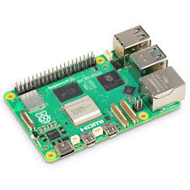
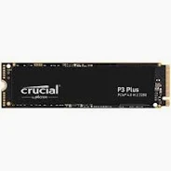
Raspberry Pi 5 and case
Specifications
RAM : 8 GB
Memory : 32 GB
Power supply : 0.5 A and 27 W
Necessary List
Keyboard and Mouse set
SSD crucial P3 Plus 512 GB (11,779 Yen)
Pironman 5 NVMe Mini PC case for Rpi 5 (13980 Yen)
5

Slide 3
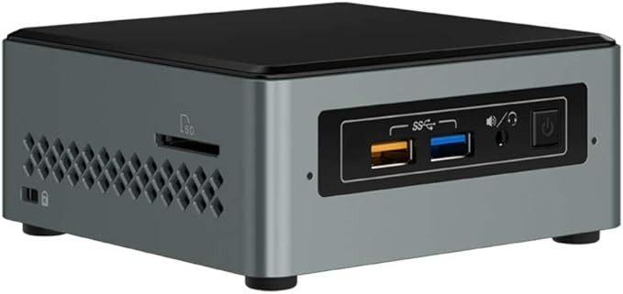
Alternative (Intel NCU)
Problems with Rpi 5
Doesn’t support Intel RealSense L515
L515 stopped support since 2018
Complicated packages installing
Possible alternatives
Use Robot operating system or other lidar package to access the data from RPI
Use intel based mini PC for the system.
5

Slide 4
Review of Non-invasive Skin Phantom Properties Estimation Using Air-jet Indentation And Active LiDAR Sensing
Aims of the research are :
To Design and integrate an air-jet module capable of delivering controlled forces with tunable pressure and nozzle configurations.
To Implement a high-resolution depth tracking system using Intel RealSense L515 to capture sub-millimeter surface deformation in real-time.
To Validate the system on phantoms by evaluating force repeatability, surface displacement accuracy, and computed stiffness / Young’s modulus within safe biomechanical thresholds.
5

Slide 5
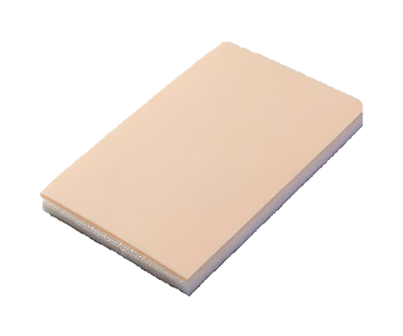
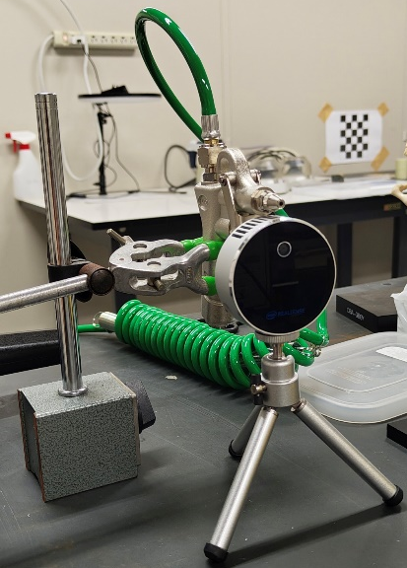
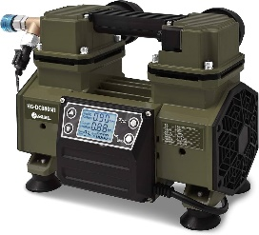
Experimental Setup
Pressure from air blower 0.9 MPa.
Distance between camera and phantom is 50 cm.
Nozzle diameter is 2 mm.
Used Ideal gas with choked flow.
Distance 50 cm
Fig. Experimental Setup
Objectives of the research are :
Fabricated the skin phantoms with known mechanical properties and controlled thickness by ensuring reproducibility for stiffness calibration.
Quantify the force and characterizes the pressure relation at nozzle exit.
Combine the air-jet and LiDAR in controlled lab conditions.
Compares with the known phantom properties for validation.
5

Slide 6
The End
THANK YOU FOR LISTENING
Thu Ta Zaw
2415121095

